Slide 1
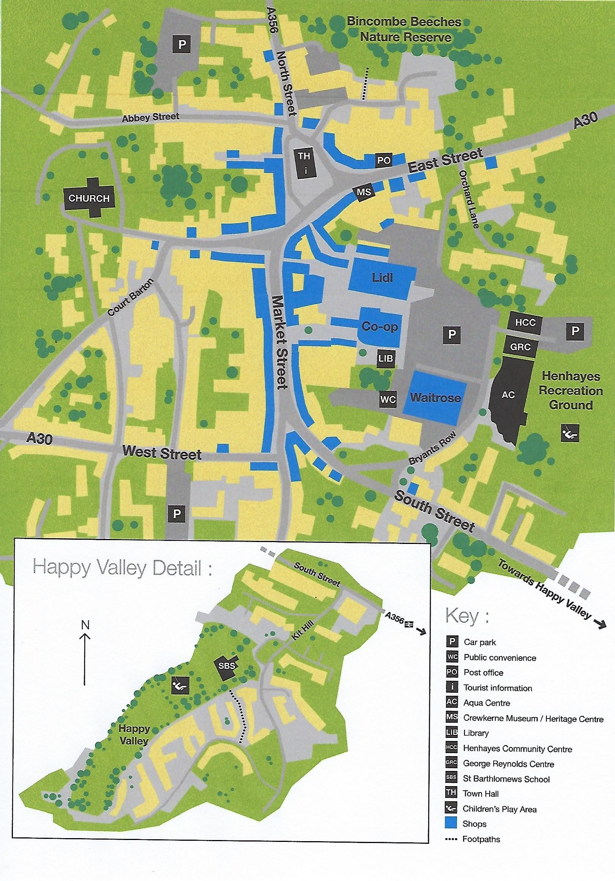

10
9
TH
Crewkerne
Antiques Trail 2024
MS
8
PO
Savers
7
6
3
4
The Antiques Bazaar TA18 8AG 01460 77121
Lawrences TA18 8AB 01460 73041
Steptoes TA18 8AX 01460 74141
Whatnots TA18 8AX 01460 74557
5.
6. Attic Antiques TA18 7LA 01460 78498
Crewkerne Antiques Centre TA18 7LA 01460 77111
Frantiques TA18 7HR 07730534345
Eleven Squared TA18 7LE 07760617113
Crooked Horn TA18 7AB 07434914771
www.dicovercrewkerne.org.uk
FB: crewkernelocalinformation lic@crewkerne-tc.gov.uk
2
1
©Crewkerne Lic

